Slide 1


Analysis of economic growth and income inequality
PRADIP HAYU
INDIVIDUAL PROJECT 2
DATS 6103 DATA MINING
27 NOVEMBER 2018

Slide 2
mission
Years compared : 2010 to 2016
Compare the world’s income per person(US $) and economic growth(%)
Compare the mean income per person and mean economic growth using a World Choropleth Map
Figure out the top 10 richest countries of the world and see the trends of their income per person and economic growth
Compare the income per person and economic growth of G-20 nations
Single out the fastest growing countries in terms of income per person and economic growth from the G-20 nations
Compare the income per person and economic growth of SAARC countries

Slide 3
DATASET SOURCE
World Bank Open Data
Links : (1) https://data.worldbank.org/indicator/NY.GDP.PCAP.CD
(2) https://data.worldbank.org/indicator/NY.GDP.PCAP.KD.ZG
Databases used were: (1) GDP Per Capita (Current US $) and (2) GDP Per Capita Growth (Annual %)
Databases include data of the world for the period 1960-2017
Databases were last updated on 10/18/18

Slide 4
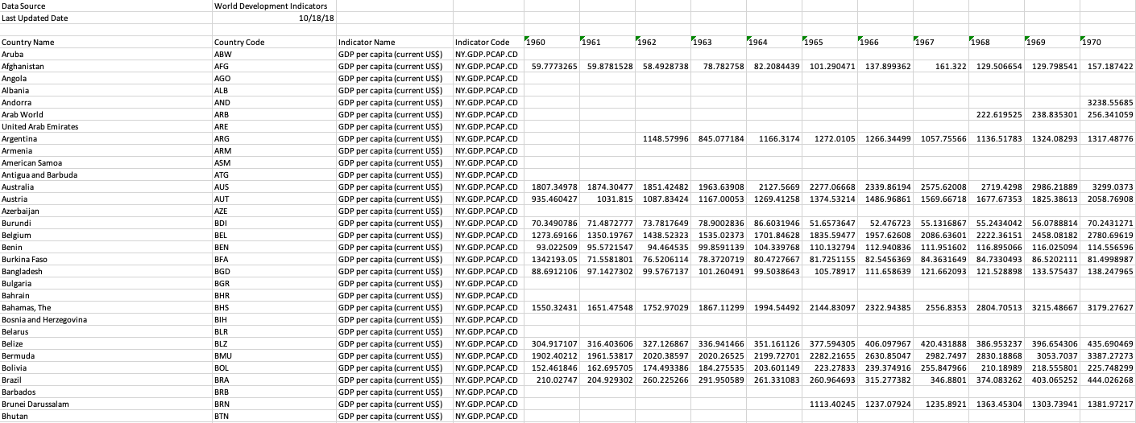
Raw data
There were a lot of blank values which were filled with zeroes in order to use the data

Slide 5
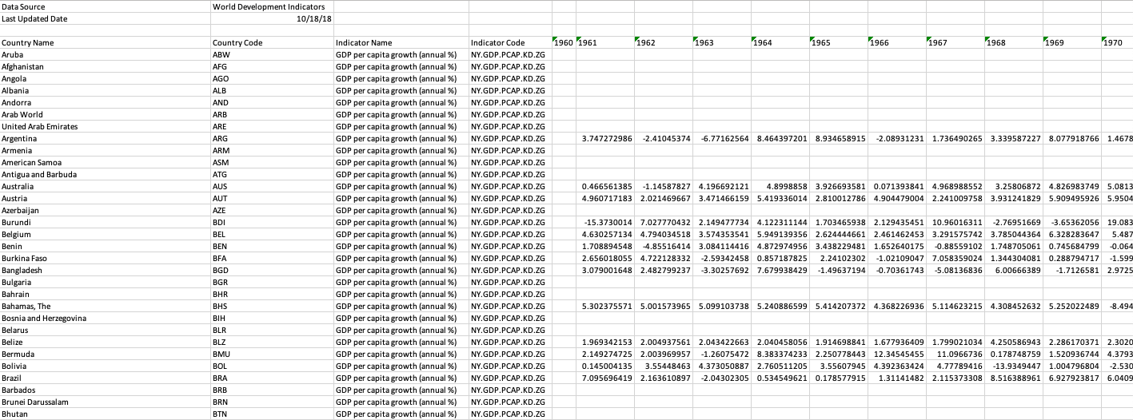
Raw data
There were a lot of blank values which were filled with zeroes in order to use the data

Slide 6
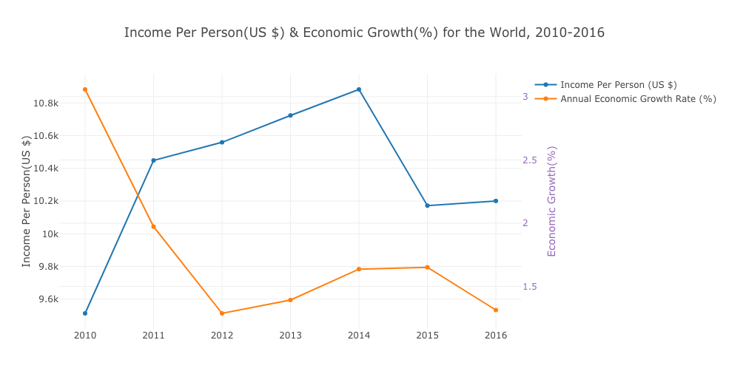
World’s income per person (US $)vs economic growth (%)
No particular relationship between world’s income per person and economic growth
Increase in world’s income per person from 2010 to 2014
Decrease in world’s economic growth from 2010 to 2012
No fixed pattern of increase or decrease in income per person and economic growth

Slide 7
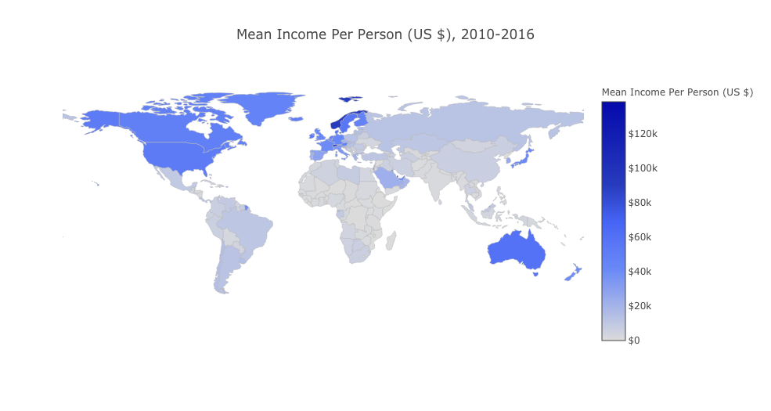
World’s MEAN income per person (US $)
Top 3:
Norway : 90.83K
Switzerland: 82.88K
Australia: 59.86K

Slide 8
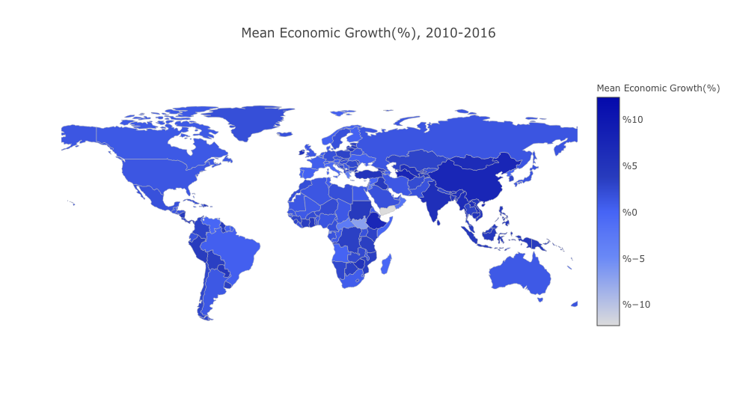
World’s Economic growth (%)
Top 3:
China : 7.56%
Mongolia: 6.51%
Myanmar: 6.49%
Note: Annual percentage growth rate of GDP per capita is based on
constant local currency.

Slide 9
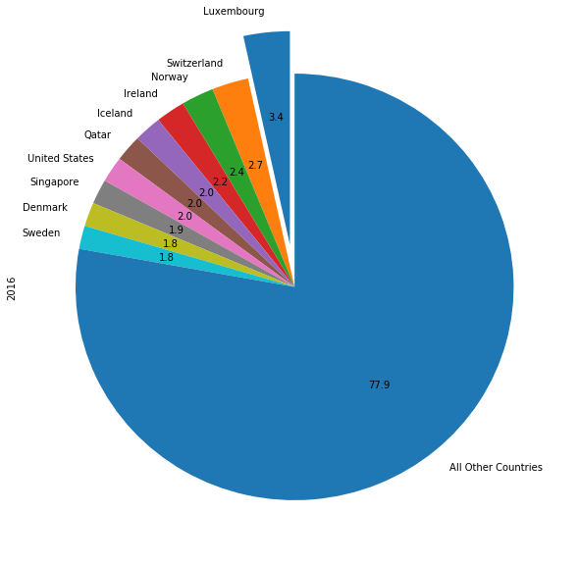
Top 10 richest countries
Based on 2016 Income Per Person

Slide 10
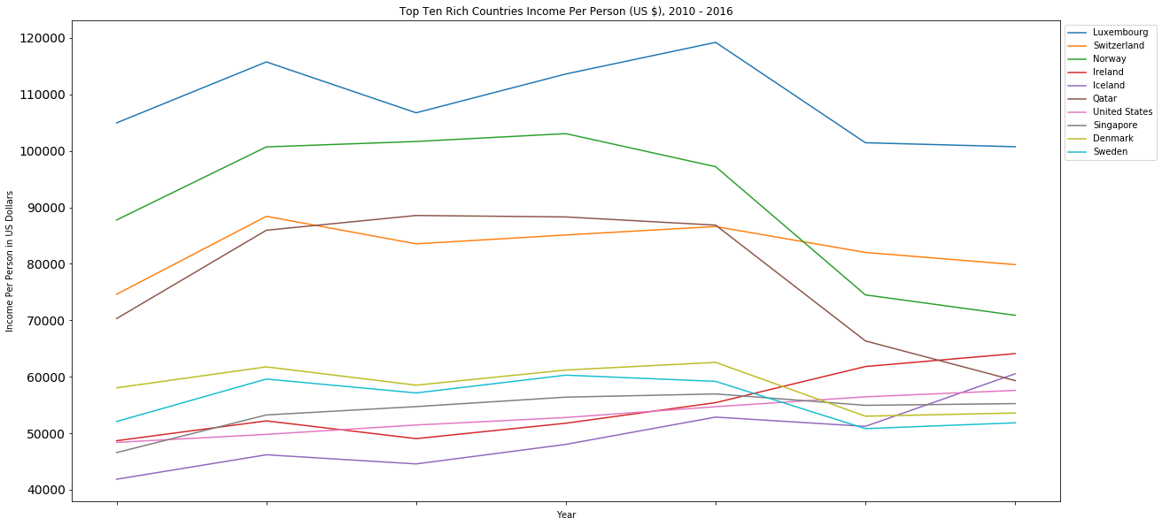
Top 10 Richest countries income per person trend
Luxembourg’s income per person was above US $100,000

Slide 11
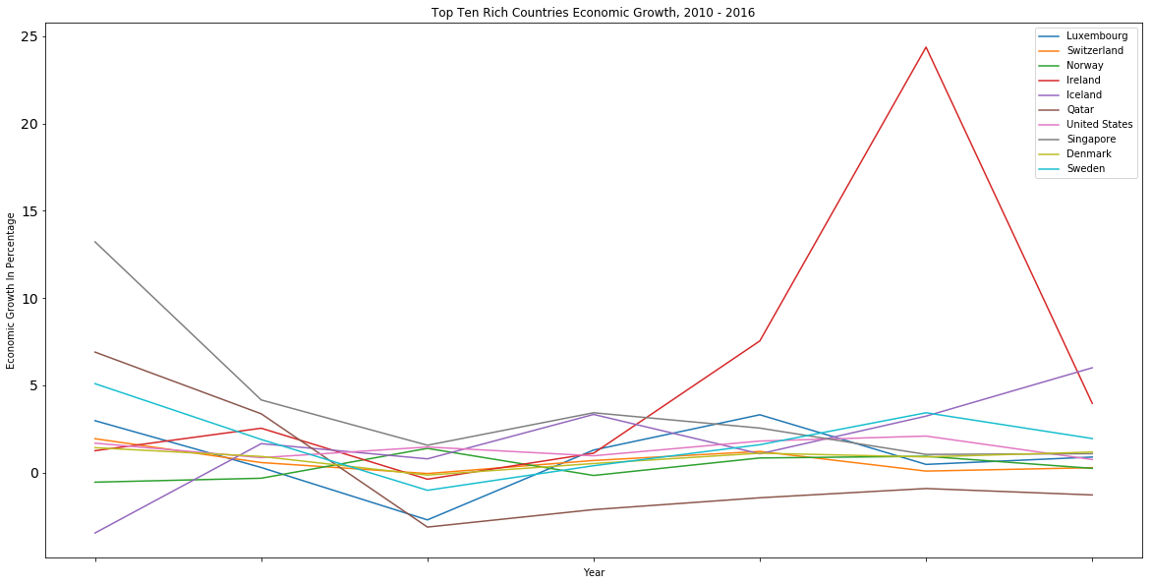
Top 10 Richest countries economic growth trend
Ireland’s economic growth reached a peak 24.376534% in 2015

Slide 12
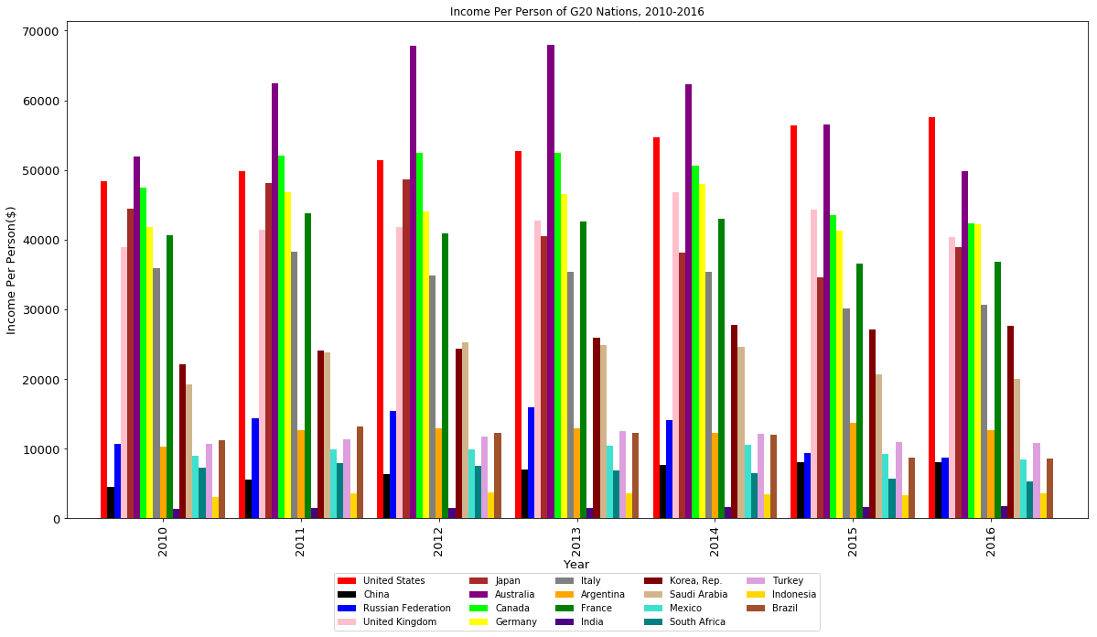
Income per person g-20 nations
Top 3: Australia, United States, Canada

Slide 13
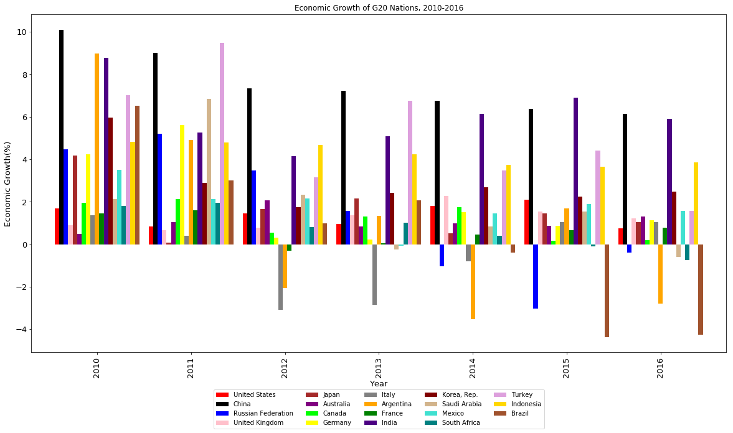
Economic growth g-20 nations
China tops the list in overall economic growth between 2010-2016

Slide 14
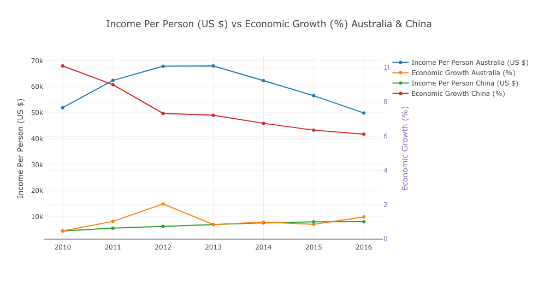
AUSTRALIA vs china
Income Per Person(US $) of Australia was way higher than that of China.
Economic Growth(%) of China was way higher than that of Australia.

Slide 15
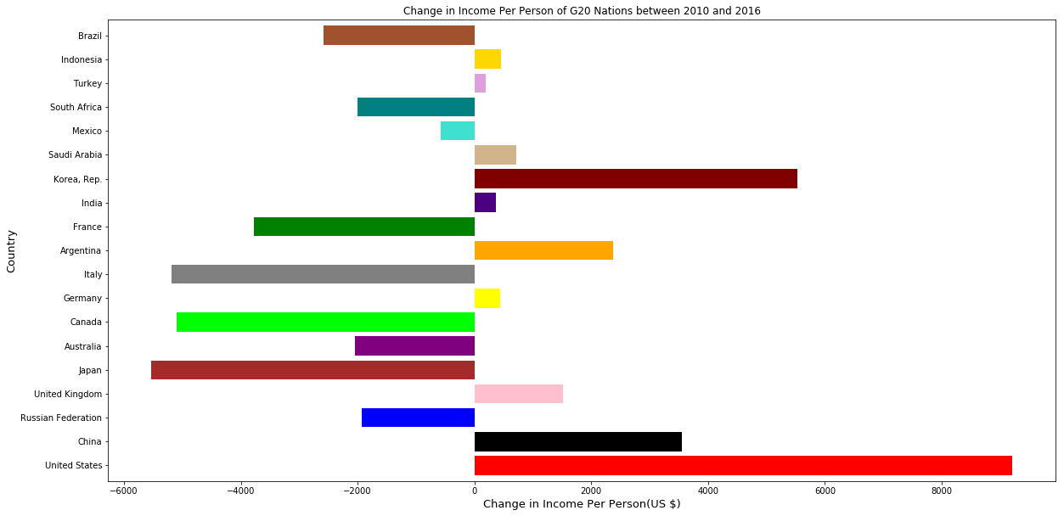
Fastest growing country - income per person – g20 nations
Top 3: United States, Korea Republic, China
The difference of 2016 and 2010 income per person of G20 Nations was taken into account

Slide 16
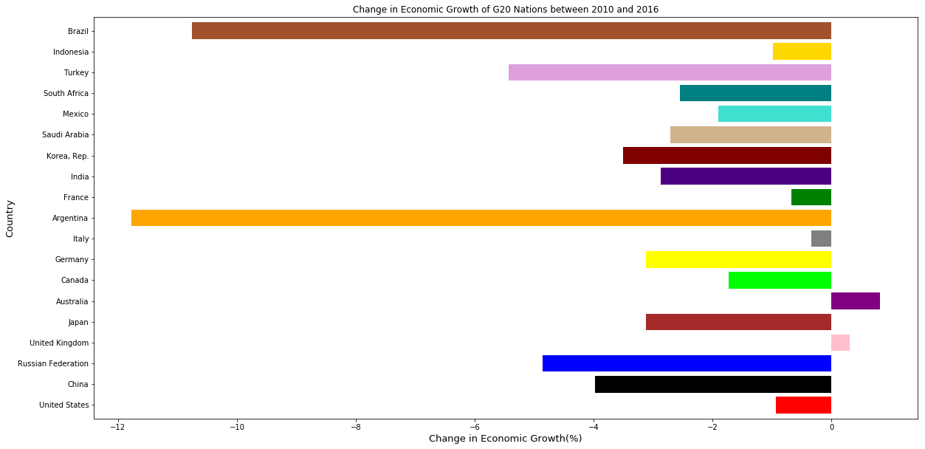
Fastest growing country - Economic Growth - g20 nations
United Kingdom and Australia were the only two G20 Nations with positive economic growth percent
when the difference between 2016 & 2010 economic growth was taken into account

Slide 17
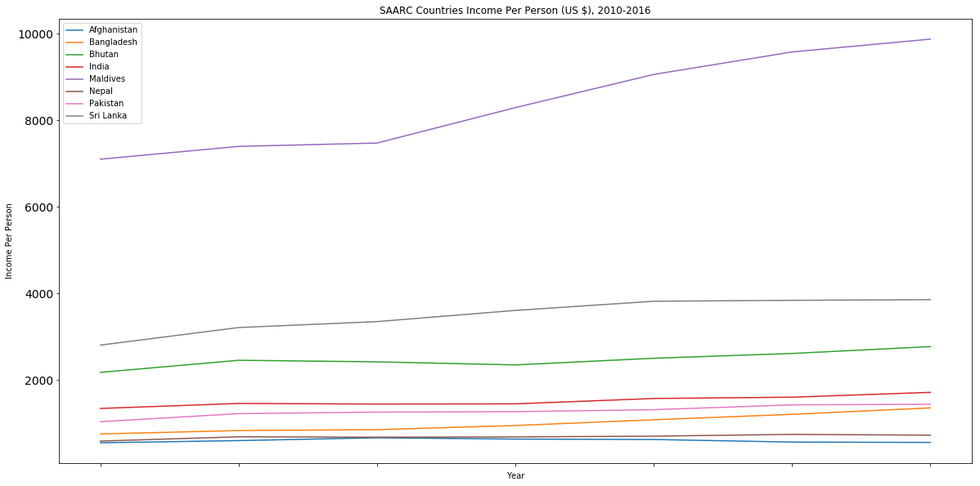
Saarc countries income per person
Maldives was way above in the spectrum followed by Sri Lanka and Bhutan

Slide 18
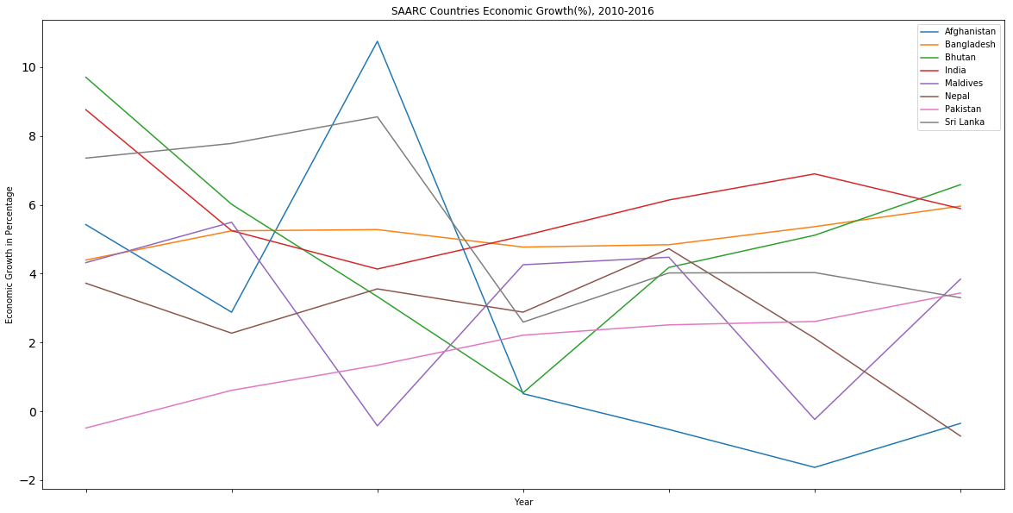
Saarc countries economic growth
Pakistan is the only SAARC nation which has consistently increased in annual economic growth rate.
However, the growth rate percentage is fairly small.

Slide 19
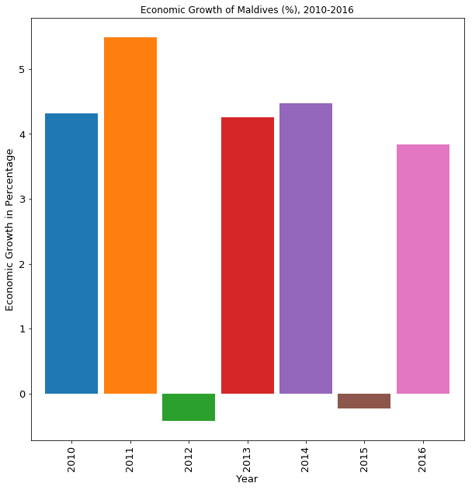
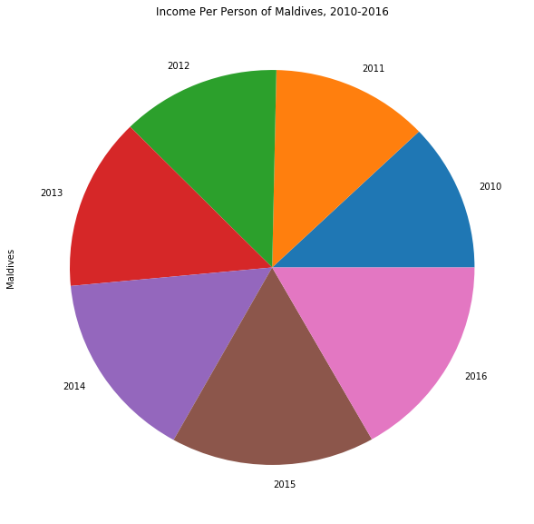
Maldives income per person & economic growth, 2010-2016
Maldives income per person fairly increased throughout 2010-2016. However, the economic growth rates
were negatives during 2012 and 2015

Slide 20
conclusions
No particular relationship/ No fixed pattern of increase or decrease between world’s income per person and economic growth.
Top 3 in terms of world’s mean income per person(US $): (1) Norway (2) Switzerland (3)Australia.
Top 3 in terms of world’s in terms of world’s economic growth(%) : (1) China (2) Mongolia (3) Myanmar. It is also important to note that annual percentage growth rate of GDP per capita is based on constant local currency.
Based on 2016 dataset, Luxembourg, Switzerland, Norway, Ireland, Iceland, Qatar, United States, Singapore, Denmark and Sweden were the top 10 richest countries. It was also found out that Luxembourg’s income per person was well above $100,000 between 2010-2016.
It was amazing to see Ireland’s economic growth of 24.376534% in 2015.
Top 3 among G20 Nations in terms of Income Per Person were Australia, United States, Canada
China topped the list of G20 Nations in overall economic growth between 2010-2016.
Income Per Person(US $) of Australia was way higher than that of China. However, Economic Growth(%) of China was way higher than that of Australia. This clearly demonstrates economic growth and income inequality.
Top 3 were United States, Korea Republic and China when the difference of 2016 and 2010 income per person of G20 Nations was taken into account. Also, United Kingdom and Australia only had positive economic growth percent when the difference of 2016 and 2010 economic growth of G20 nations was implemented.
Out of all the SAARC countries, Maldives had the highest income per person. However, Pakistan was the only SAARC nation which had consistently increased in annual economic growth rate.

Slide 21
Learning processes
Python is a fun language
“A picture speaks a thousand words” - Matplotlib is a popular Python library that helps a person to visualize the data clearly and understand it thoroughly. Plotly serves the same function empowered by online collaborative data analysis and graphing tool.
Build something, anything to keep learning Python
With more experience in Python, I can definitely improve my code

Slide 22
References
Choropleth Maps. (n.d.). Retrieved November 10, 2018, from https://plot.ly/python/choropleth-maps/
GDP per capita (current US$). (n.d.). Retrieved November 10, 2018, from https://data.worldbank.org/indicator/NY.GDP.PCAP.CD
GDP per capita growth (annual %). (n.d.). Retrieved November 10, 2018, from https://data.worldbank.org/indicator/NY.GDP.PCAP.KD.ZG

Slide 23
THANK YOU

